Slide 1

Interview Feedback Management System.
By:-
Ujjwal Verma ujjwalvarma6948@gmail.com

Slide 2
Content:-
Project Features and Technology Stack
Future Scope, Demo Screenshots and Conclusion
Architecture and Api Design and Diagrams

Slide 3
Project Features:- Enhancing Interview Management with Efficiency and Transparency
Role Based Access Control:-Secure authentication and authorization for Hr managers & interviewers
Interview Scheduling and Management:-Seamless interview Creation, assignment and scheduling Automated notifications for interviewers and candidates.
Feedback Collection and Analysis:-Structured Feedback submission with skill ratings and comments, Decision-making support for HR with historical interview data.
User-Friendly Dashboard and UI:-Intutive interface for easy navigation and usablity
Machine Learning Integration (Future Scope):-Potential implementation of AI Based insights for interview feedback analysis, Predictive analysis for candidate selection trends.

Slide 4
Technology Stack:- Robust and Scalable Architecture for IFMS
Frontend:-Vue.js(JavaScript framework for dynamic UI),Fetch API
Bootstrap:-(For responsive Design)
Backend:-Java 17(Core Backend Logic and Api Documentation),SpringBoot(Microservice framework for REST API)
Spring Security(Authentication and Role Based Access Control)
JWT(JSON Web Token for secure authentication)
Database:-PostgreSQL(Relational Database for structured data Storage.

Slide 5
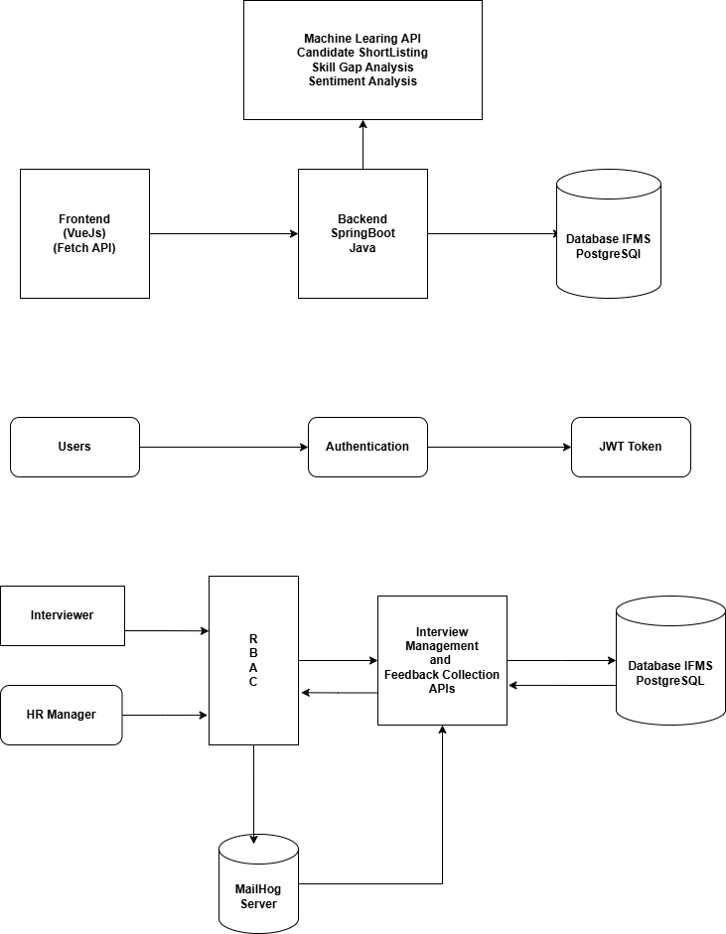
System Architecture:- scalable and secure Architecture of IFMS

Slide 6
ER Diagram:- Database Design of the IFMS
Tables:-
User Table:-Stores User Information Attributes:- id,name,email,password,role Interview Table:-Stores interview Details Attributes:- id,candidate_name,candidate_email,scheduled_at,status,interviewer_email,interviewer_name,hr_manager_id. Feedback Table:-Stores Feedback provided by interviewers. Attributes:- id,interview_id,interviewer_id,decision,commets Skill Rating Table: Stores detailed skill assessments for candidates. Attributes:- id,feedback_id,skill_name,rating,topics,comments

Slide 7
Future Scope:-
AI Powered Candidate evaluation:- Implement Machine Learning models to analyze feedback patterns and predict candidate suitability. Automated Interview Scheduling:- Use AI driven smart scheduling to optimize interview slot allocation. Enhanced Analytics and Reporting:- Generate insights and visualisations on interview trends,candidate performance and hiring decisions.

Slide 8
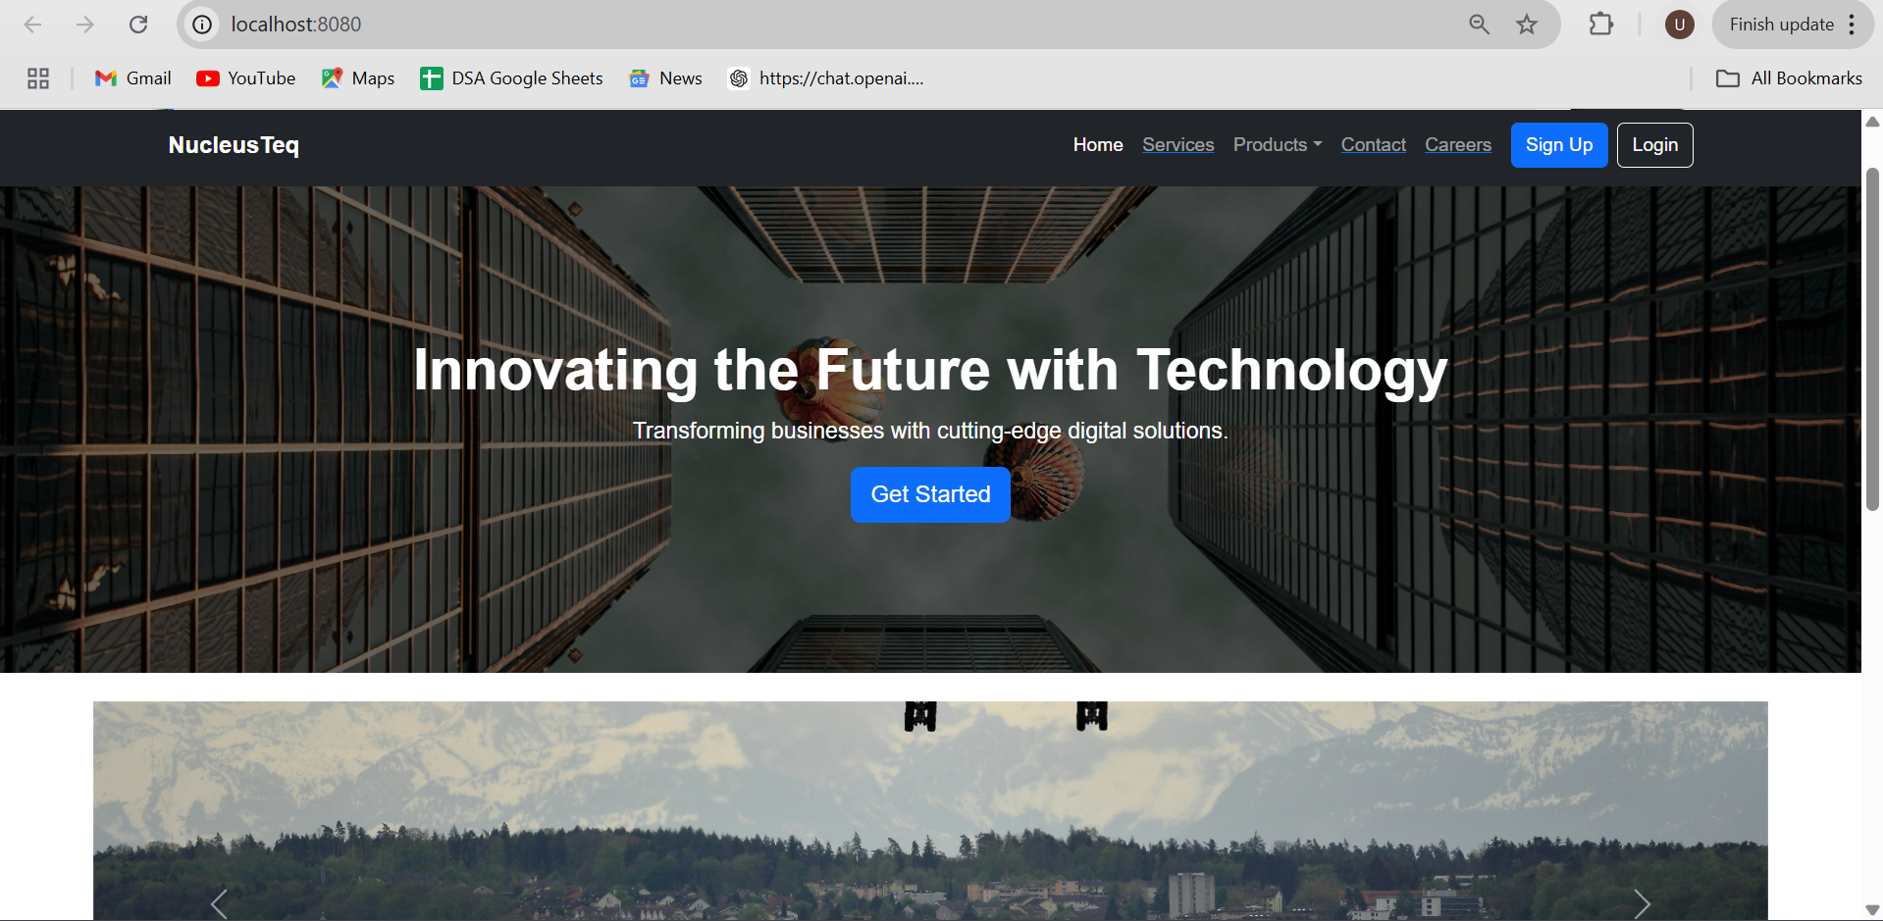
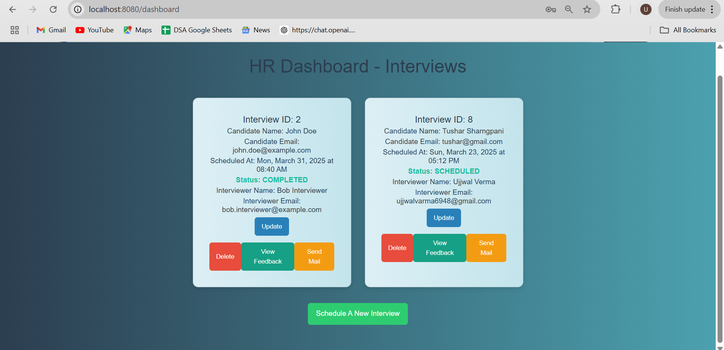
Demo Screenshots:-

Slide 9
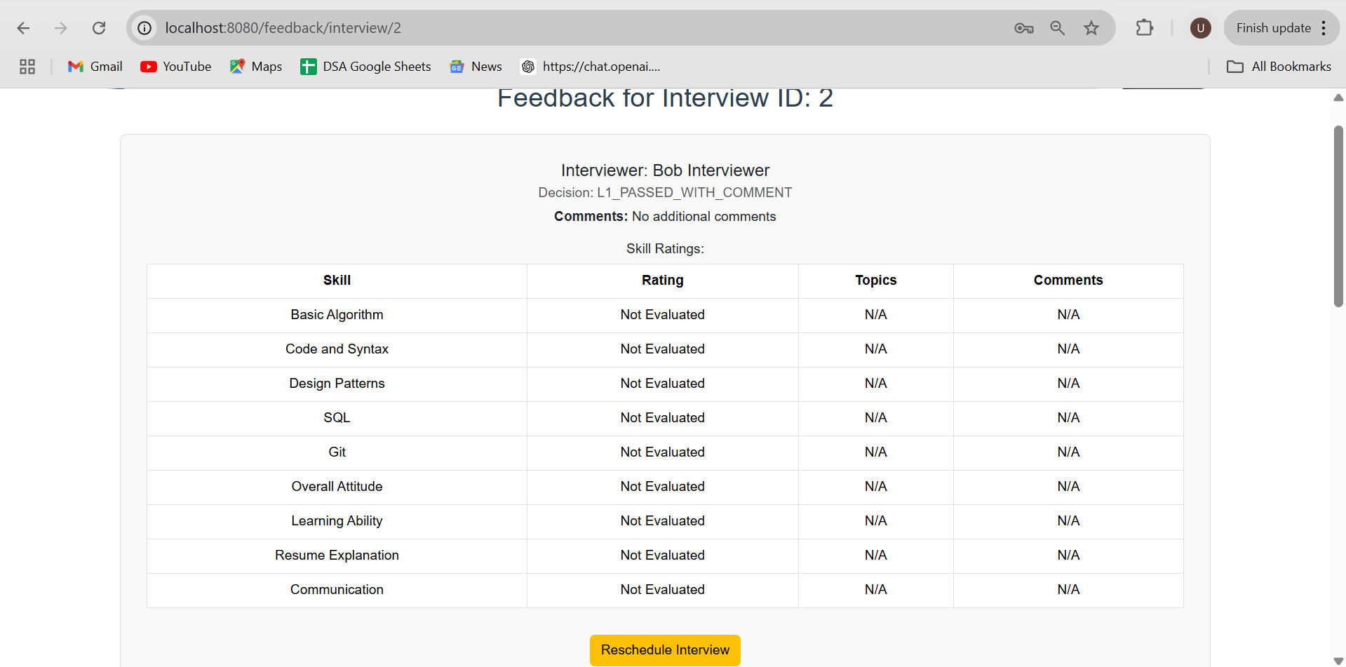
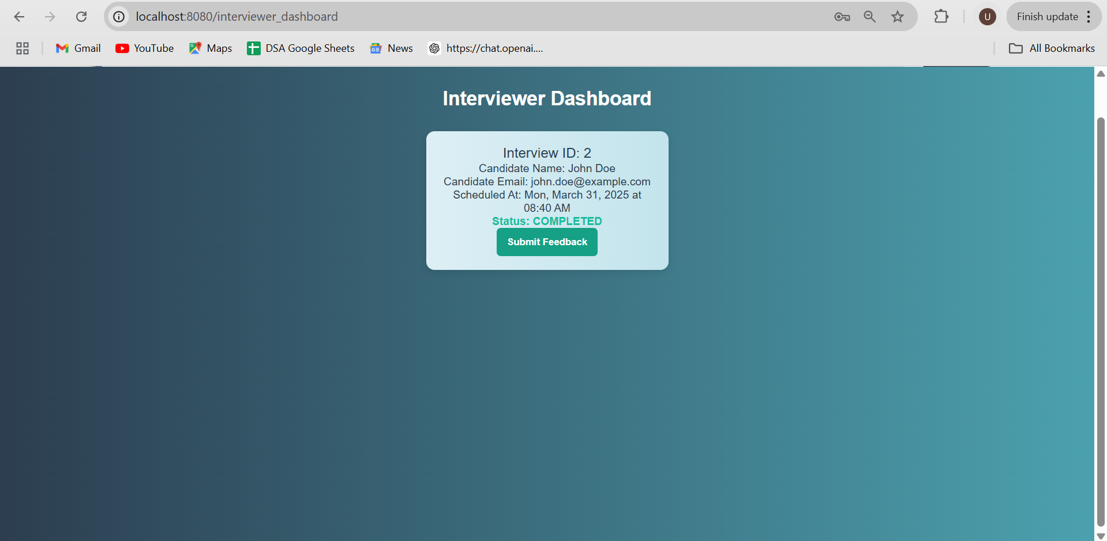
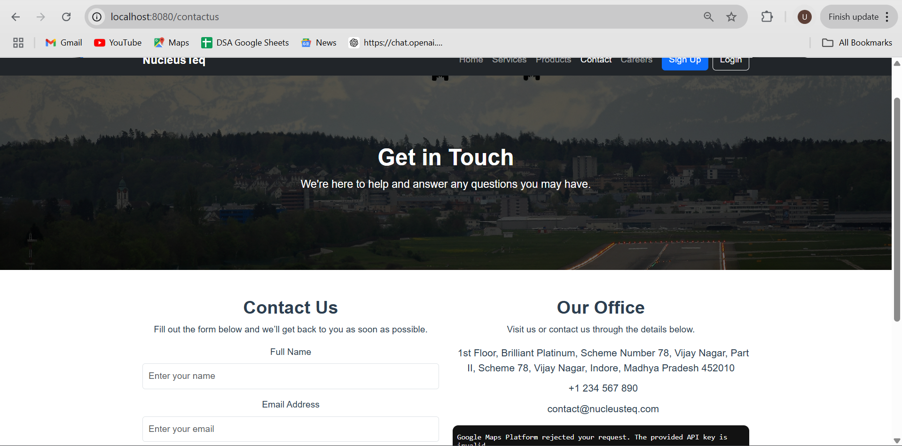
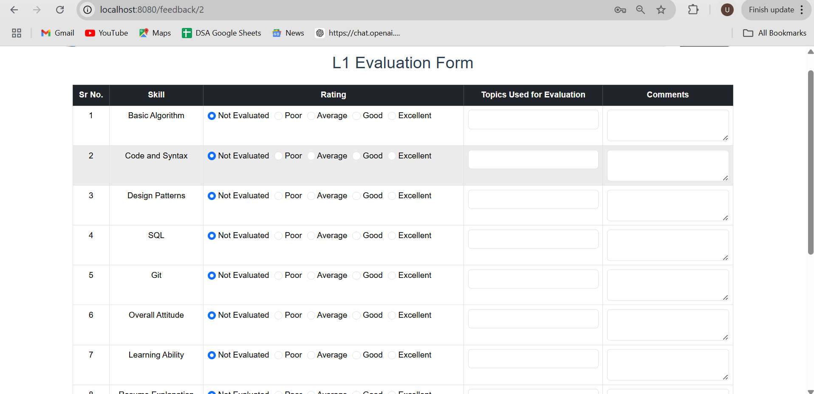

Slide 10
Challenges and Learnings:-
Challenges:- Data Security and Compliance:- Ensuring secure password storage (bcrypt hashing) and protecting sensitive data. Frontend and Backend Integration:- Ensuring smooth communication between Vue.js(frontend) and (SpringBoot) Backend using Fetch API
Security:- Deepened Knowledge of full stack development(Springboot, Vuejs, PostgreSQL) Improved Problem Solving Skills in debugging API Failures and performance bottlenecks. Importance of version control (Git, GitHub) in collaborative development.

Slide 11
Conclusion:-
Interview Feedback Management System (IFMS) successfully streamlines the interview process, ensuring structured feedback collection and efficient decision-making
Key technical highlights include a secure authentication system, role-based access control (RBAC), RESTful API design, and a scalable architecture.
The project provided valuable hands-on experience in full-stack development, integrating Java Spring Boot, Vue.js, and PostgreSQL with modern web development best practices. Future enhancements like AI-driven feedback analysis and predictive analytics can further improve decision-making and efficiency.

